Slide 1
Genome-enabled prediction using highly dimensional markers and environmental covariates

Slide 2
Outline
Phenotype GE
→Multiplicative operator for Genotype x Environment
interaction (GE) (random or fixed)
Phenotype GE and EC
→Multiplicative operators for GE with covariables
(environmental covariables, EC; and/or genotypic
covariables) (random or fixed)
Phenotype GE and additive (A)
→Linear mixed models for modeling GE with additive
and additive x additive effects
Phenotype GE and genomic
→Genomic linear mixed models for modeling GE with
pedigree and marker information
Phenotype GE with genomic and EC
→ Random models for GE with highly dimensional
marker and environmental covariables

Slide 3
Multiplicative operator for GE
(suggested since 1923 by RA Fisher and W.A. McKenzie)
Phenotype is the result of specific genotype responses, g(α), to specific environmental effects, e(γ)
It is proposed a joint multiplicative operator between these two effects -- g(α)e(γ) -- to reflect non-additivity (i.e., non-separability), or additivity (i.e., separability) of effects .
In multi-environment trials (METs), additivity rarely occur, and a joint multiplicative operator of the g(α)e(γ) type needs to be defined for studying the non-addtivity or additivity of effects.

Slide 4
BASELINE MODEL
Response of the i^{th} genotype in the j^{th} environment
Product operator for GE
Regresion on site mean
SVD
SVD
Latent variables
(i.e. FA)

Slide 5
Product operators for GE with external covariables
For h=1,…,H enviromental covariables (centered),
Regression
on covariables
For k=1,…,G genotypic covariables (centered)
Regression
on covariables

Slide 6
Modeling GE with additive effects
HOW TO MODEL GE ?
Different (co)-variance structures are available.
The factor-analytic (FA) model expresses the random effect of the i^{th} genotype in the j^{th} environment as a linear function of scores with loadings plus a
residual

Slide 7
Modeling GE with additive and additive x additive effect
When model
with FA

Slide 8
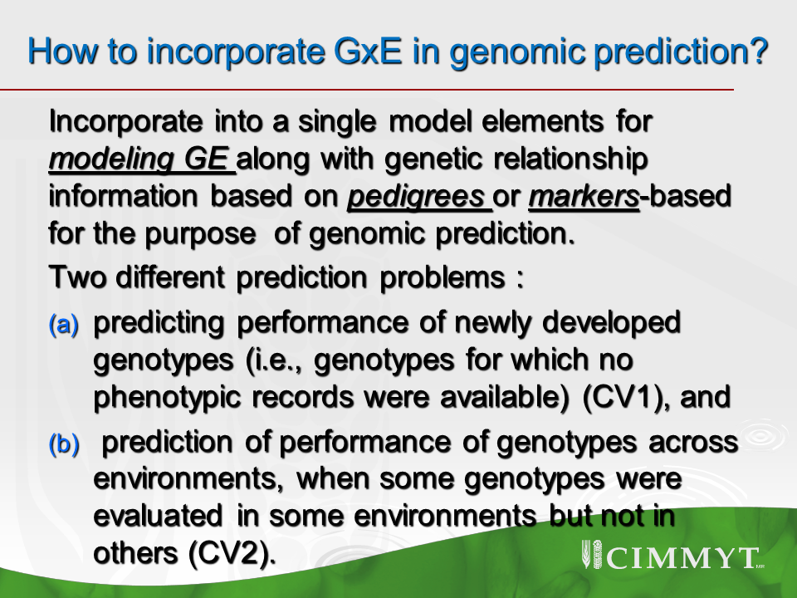
HOW TO INCORPORATE GE INTO GENOMIC
PREDICTION

Slide 9
Pedigree and genomic models for multi-environment plant breeding trials with GE
(marginal density of the data)
Models with only pedigree or only markers
Models with pedigree + markers
Models with epistasis from pedigree or from markers
Use FA model for modeling marker or pedigree additive x environment and additive x additive x environment interactions

Slide 10
Data: Wheat 599 lines in 4 environments with 1442 markers
2.0
1.5
1M_{FA}
1.0
1P_{FA}
Factor 2
3M_{FA}
0.5
2M_{FA}
3P_{FA}
0.0
2P_{FA-}
4M_{FA}
4P_{FA}
-0.5
-1.0
-3.0
-2.5
-2.0
-1.5
-1.0
-0.5
0.0
0.5
1.0
1.5
Factor 1

Slide 11
Average (across four environments) correlations between predicted and observed performance derived from models using only pedigree, only markers or pedigree + markers for two cross-validation schemes (CV1 and CV2).

Slide 12
Mean correlations between the predicted and observed values of genotypes for individual environments (E1, E2, E3, E4), and for three environments combined (E2, E3, E4) using five different factor analytic models (FA) for a cross-validation scheme (CV2), each with 10-fold cross-validation. The most accurate models are underlined.
 |  | FA additive pedigree | FA additive genomic | FA pedigree additive, FA genomics additive | FA pedigree additive, FA pedigree additive × additive | FA genomic additive, FA genomic additive × additive
E1 |  | 0.437 | 0.467 | 0.469 | 0.512 | 0.554
E2 |  | 0.610 | 0.621 | 0.638 | 0.612 | 0.637
E3 |  | 0.631 | 0.577 | 0.612 | 0.634 | 0.603
E4 |  | 0.513 | 0.458 | 0.448 | 0.531 | 0.465
E2 E3,E4 |  | 0.585 | 0.552 | 0.566 | 0.592 | 0.568

Slide 13
How to assess GE? -- estimate genetic correlations of line performance across environments
Correlations summarize the collective action of genes and environmental conditions, regardless of how different regions of the genome interact with different environmental factors.
In theory, the magnitude and sign of the interaction between genes and environmental conditions may vary across genes

Slide 14
How to assess marker x environment?
Mapping of chromosome regions associated with phenotypic variability (e.g., QTL mapping)
Differential response of these chromosome regions across environments (QTL×environment interaction, QE)
Models for QE have been applied both in the context of fixed-effects regression, and in a mixed-effects regression models; these extended to multi-environment multi-trait model settings.

Slide 15
Highly dimensional data information
With modern genotyping and sequencing technologies, molecular marker information has become highly dimensional, with the number of markers (p) exceeding by large the number of data-points (n) available for model fitting.
Similarly, environmental information is also becoming highly dimensional owing to the development of information systems that allow continuous monitoring of environmental conditions.

Slide 16
How to confront the challenges of highly dimensional predictors
The principles used in models for GS using highly dimensional predictors could also be exploited for modeling the effects of large numbers of environmental covariables, EC.
Need a methodology for modeling interactions between two sets of highly dimensional predictors: markers and ECs

Slide 17
Proposition
A class of random effects models with the main effects of markers and ECs, and their interactions are introduced using co-variance structures that are functions of marker genotypes and ECs.
An extension of the GBLUP that uses a random effects model on all the markers, all the ECs, and all the interactions between markers and ECs using a multiplicative operator.

Slide 18
MAIN EFFECT MODELS
BASELINE (EL)
GENOMIC COVARIABLES (EG)
Replace L_{i} in EL with
GENOMIC and ENVIRONMENTAL COVARIABLES (WG)
Replace E_{j} in EG with
and
Notes:
The ECs may not fully describe differences across environments, perhaps because some relevant ECs may not have been measured or because of model miss-specification (e.g., non-linear effects of ECs on the trait of interest). Similarly, because of imperfect linkage disequilibrium (LD) between markers and genes at causal loci or because of model miss-specification (e.g., interactions between alleles that are unaccounted for), the regression on markers may not fully describe genetic differences among lines. One possibility is to combine models [1] and [3] into a single model of the following form:

Slide 19
Markers x EC interaction models
A parsimonious model for incorporating interactions using co-variance structures
1st order multiplicative model -- where the interaction is the product of two random linear scores (genetic and environmental)
linear function of markers
linear function of EC
genetic scores
environmental scores
where and are entries of G and of
Notes:
G describes genetic similarity between line
Environmental covariances structure describes the similarity between environmental conditions

Slide 20
Random process obtained by multiplying both random scores
Thus, the cov of is the cell by cell product of and
Then, the WG-G×W model is
Notes:
These types of covariance functions are not new to quantitative genetic methods; indeed, Cockerham (1954) and Kempthorne (1954) arrived at these type of co-variance functions when studying the degree of resemblance between relatives generated by epistatic interactions (e.g., additive by additive and additive by dominance).

Slide 21
How much of GE is explained by ?
Due to imperfect LD between alleles at markers and alleles at QTLs, markers may not fully account for genetic differences between lines.
ECs may not fully account for differences due to environmental conditions.
Therefore, some proportion of the GE may not be fully captured by the interaction term

Slide 22
Introducing Highly Dimensional Genomic and Environmental Covariate Data into Models for Prediction of Complex Traits
D. Jarquín, J. Crossa, X. Lacaze, P. Du Cheyron, J.Daucourt, J. Lorgeou, F. Piraux, L. Guerreiro, J. Burgueño and G. de los Campos
Theoretical and Applied Genetics

Slide 23
DATA from Arvalis
7,876 records of grain yield collected on 139 commercial lines tested in eight different years (from 2003-10) and various locations within northern France.
There were a total of 340 location by year combinations and these were regarded as the environment.
All environments had a meteorological station within a distance of less than 10 km, and soil characteristics at each location were analyzed.
A total of 130 ECs that described environmental conditions were collected.
The phenology of the crop was divided into 5 phases (1 cm, 1 cm to spiking, spiking to flowering, flowering to milk stage and milk stage to harvesting)
Lines were genotyped for 3,548 SNPs using an insertion site-based polymorphism technique.
Trait analyzed was grain yield (15% moisture content)

Slide 24
MODELS FITTED
Model |  | Factors included
 |  | Main effect |  |  |  |  | Interaction
 |  | E | L | G | W |  | G×E | G×W
EL |  | X | X
EG |  | X |  | X
ELW |  | X | X |  | X
EGW |  | X |  | X | X
EGW-G×E |  | X |  | X | X |  | X
EGW-G×W |  | X |  | X | X |  |  | X
EGW-G×W G×E |  | X |  | X | X |  | X | X
 | E=Environment; L=Line; G=marker covariates; W=environmental covariates; G×E= interaction between environments and markers; G×W=interactions between markers and ECs.

Slide 25
CROSS-VALIDATIONS
CV1 CV2
E1 E2 E3 E4 E5 E1 E2 E3 E4 E5
Line 1 | Y₁₁ | Y₁₂ | Y₁₃ | Y₁₄ | Y₁₅ |  | Y₁₁ | NA | Y₁₃ | Y₁₄ | Y₁₅
Line 2 | Y₂₁ | Y₂₂ | Y₂₃ | Y₂₄ | Y₂₅ |  | Y₂₁ | Y₂₂ | NA | Y₂₄ | Y₂₅
Line 3 | NA | NA | NA | NA | NA |  | Y₃₁ | Y₃₂ | Y₃₃ | Y₃₄ | NA
Line 4 | Y₄₁ | Y₄₂ | Y₄₃ | Y₄₄ | Y₄₅ |  | Y₄₁ | Y₄₂ | Y₄₃ | NA | Y₄₅
Line 5 | Y₅₁ | Y₅₂ | Y₅₃ | Y₅₄ | Y₅₅ |  | NA | Y₅₂ | Y₅₃ | Y₅₄ | Y₅₅

Slide 26
Model | Variance component
 | Estimate |  |  |  |  |  |  | Percentage of the within-environment variance¹
 | E | L | G | W | G×E | G×W | Res. | L | G | W | G×E | G×W | Res
EL | 199.7 | 12.3 |  |  |  |  | 22.6 | 35.2 |  |  |  |  | 64.8
EG | 199.0 |  | 14.9 |  |  |  | 22.6 |  | 39.7 |  |  |  | 60.3
EW | 153.5 |  |  | 23.7 |  |  | 27.7 |  |  | 46.1 |  |  | 53.9
ELW | 143.7 | 12.9 |  | 24.9 |  |  | 22.1 | 21.5 |  | 41.6 |  |  | 36.9
EGW | 145.6 |  | 14.6 | 23.3 |  |  | 22.1 |  | 24.3 | 38.8 |  |  | 36.8
EGW-G×E | 148.0 |  | 14.4 | 20.2 | 5.9 |  | 16.4 |  | 25.3 | 35.5 | 10.4 |  | 28.8
EGW-G×W | 146.7 |  | 12.8 | 22.3 |  | 5.3 | 18.3 |  | 21.8 | 38.0 |  | 9.0 | 31.2
EGW-G×WG×E | 148.6 |  | 12.7 | 19.8 | 3.9 | 5.0 | 14.9 |  | 22.6 | 35.2 | 6.9 | 8.9 | 26.5
Notes:
E explained the largest proportion 144-200
When predicting ranks within an environment the variability due to environmental mean is a nuisance factor that need to be removed.
When including W the var(E) decreased from 200 to 145 indicating that EC capture a sizeable proportion of across environments variation; however even after EC, E continue to be the main source of variability
When including G this explained most if not all the variability due to main effects of G
Inclusion of GxE GxW and DxW GxE induced reduction in residual variance
Most comprehensive model EGW-GxW GXE G explained 22% of the within site variability,
W explained 35.2 and the interactions explained 16%.
When interaction is not included the variance of G and W increased suggesting that when interaction is omitted some of this variance goes to the main effect

Slide 27
PREDICTION ACCURACY
Models | CV1 |  | CV2
 | Estimate | 95% CI* |  | Estimate |  | 95% CI*
EL | 0.060 | [0.038, 0.082] |  | 0.425 | [0.405, 0.445]
EG | 0.175 | [0.153, 0.197] |  | 0.425 | [0.405, 0.445]
EVW | -0.006 | [-0.028, 0.016] |  | 0.441 | [0.421, 0.461]
EGW | 0.172 | [0.150, 0.194] |  | 0.442 | [0.422, 0.462]
EGW-G×E | 0.192 | [0.170, 0.214] |  | 0.457 | [0.437, 0.477]
EGW-G×W | 0.196 | [0.174, 0.218] |  | 0.506 | [0.487, 0.525]
EGW-G×WG×E | 0.211 | [0.189, 0.233] |  | 0.513 | [0.494, 0.532]

Slide 28
20%, 50% and 80% empirical percentiles
62% of the top 20% lines (based on prediction) would have a performance above the median

Slide 29
20%, 50% and 80% empirical percentiles
80% of the top 20% lines (base on prediction would have a performance above the median

Slide 30
CONCLUSIONS
Modeling GE by multiplicative operators in multi-environments plant breeding trials increase prediction of unobserved genotypes.
The joint use of pedigree and markers when modeling GE increase prediction accuracy by exploiting information of relative and correlated environments.

Slide 31
CONCLUSIONS
Covariance function induced by a multiplicative mode of interaction is simply the Hadamard product of two covariance structures: one defining similarity based on markers (the G matrix used in standard GBLUP) and one describing similarity between records due to ECs (Ω)
For the Arvalis data set and incorporating the interaction defined by the cell-by-cell product of GΩ
→ 24% (CV1) and 21% (CV2) increased in
prediction accuracy is observed as compared
with the model that does not include interaction

Slide 32
http://genomics.cimmyt.org
Thanks!!
j.crossa@cgiar.org

