Slide 1
Genomic selection in CIMMYT: Theory and practical results
,
Jose Crossa
Collaborative work between
CIMMYT-Biometrics and Statistics Unit (Mexico),
CIMMYT-Global Wheat Program (Mexico),
CIMMYT-Global Maize Program (Mexico),
Colegio de Postgraduados (COLPOS) (Mexico)
Cornell University (USA),
Kansas State University (USA),
Michigan State University (USA),

Slide 2
Modern breeding – accelerating food production
“Oldest domesticated animals are still capable of rapid improvement or modification.” (Darwin,1895)
Examples are plants and animals where the food achieve the market weights in 1/3 or less time than it was required 30 or 40 years ago while consuming less resources.
These gains in breeding programs have been achieved by estimating the genetic merits (breeding values) of the selection candidates based on
PHENOTYPIC and PEDIGREE information.

Slide 3
OUTLINE
Breeder’s equation
Genomic prediction incorporating GxE
    Reaction norm model
    Marker x Environment kernel regression models
Predicting wheat lines yield in South Asia environments
→ Challenges of BIG DATA (pedigree and marker)
Genetic gains in maize grain yield using Genomic Selection
→ rapid cycling bi-parental
→ rapid cycling multi-parental
How is the performance of maize hybrids developed from GS
lines?

Slide 4
Accelerating genetic gains in plant breeding
  Selection intensity x h σ_{A}
  Breeder’s equation =
  INTERVAL
Fundamentals
Experimental designs and control of the plot-to-plot variability
GxE -- correlation among experimental trials
Population size in multi-environment trials.
Genetic diversity
INTERVAL=Years/Cycle
Genomic selection
High throughput phenotyping
Double haploids
Multi-traits Indirect selection using
correlated traits

Slide 5
Genomic prediction incorporating GxE
Reaction Norm Model (Jarquin et al., 2014)
→ The strategy allows modeling interactions using co-variance functions
similar co-variance structures emerged in quantitative genetics for
modeling epistatis
How and why this approach may work? Borrowing information between
lines occur only if the lines have genetic and environmental similarity.

Slide 6
Prediction results of 700 wheat lines genotyped with 15,000 markers in 5 environments
Scheme 1 = 200 lines missing in all 5 environments
Scheme 2 = 200 lines missing in some environments but
present in other environments
MODEL | Scheme1 200 lines | Scheme2 200 lines
E+G | 0.242 | 0.299
E+G+(GxE) | 0.430 | 0.517

Slide 7

Marker x Environment Interaction model
Proposition (Lopez-Cruz et al. 2015)
We set the effect of the k^{th} marker in the j^{th} environment as
$$β_{jk}=b_{0k}+b_{jk}$$
→ $b_{0k}$ is a main effect of the k^{th} marker across all environments
→ $b_{jk}$ is an interaction term representing deviations from the main
effect due to marker × environment interaction.
→Shrinkage (penalize regression) (e.g., RIDGE BLUP)
→Variable selection (e.g Bayes B)
Estimated prediction accuracy - correlation between predicted and observed yield, averaged over 50 partitions, cycle 2015-14 (800 wheat candidates).
 | Environments |  | Single Environment) | MxE Interaction model
 | 1 |  | 0.529 | 0.591
 | 2 |  | 0.622 | 0.697
 | 3 |  | 0.452 | 0.505
 | 4 |  | 0.493 | 0.516

Slide 8
MARKER MAIN EFFECT
MASRKER EFFECT ENVIRONMNT 1
MASRKER EFFECT ENVIRONMNT 2
MASRKER EFFECT ENVIRONMNT 3
MASRKER EFFECT ENVIRONMNT 4

Slide 9
Procedures for genomic-prediction of ~ 60K wheat lines
Pedigree, Markers, and Phenotypic data
TOTAL 59,406 lines with pedigree (2010-2015)
TOTAL 20,847 lines with GBS and pedigree (2010-2015)
→ 2015-2015 Predict ~9,000 lines in OPTIMUM
→ 2013-2014 Predict~5,000 lines in OPTIMUM,
DROUGHT, LATE HEAT, and SEVERE DROUGHT
Predict ~ 400 wheat lines in three sites in India (Ludhiana, Jabalpur and Pusa) in two years (2013 and 2014)

Slide 10
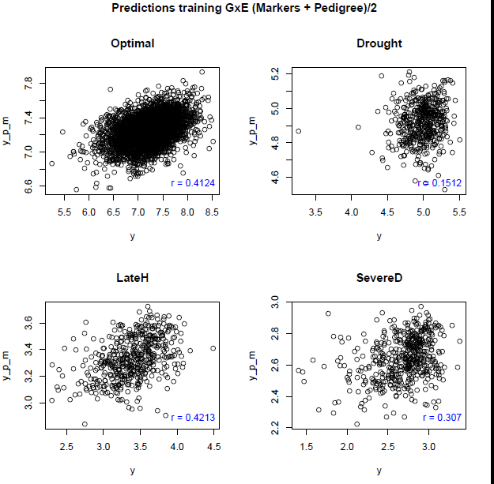
testing

Slide 11
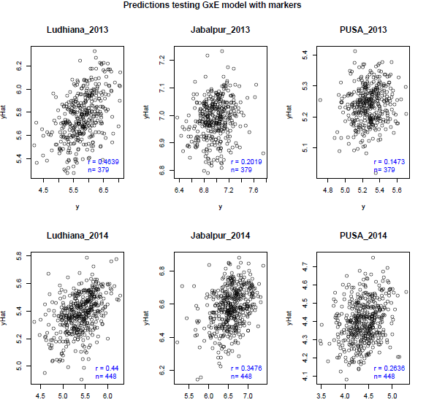

Slide 12
Rapid cycling -- gains in grain yield using GS in 8 bi-parental maize populations under drought environments in Sub-Saharan Africa
Beyene et al. (2015) Crop Sci. 55:154–163
Entries | Across eight populations | Three populations | Five populations
 | Grain Yield (ton/ha)
C₀ | 2.286 | 2.410 | 2.212
C₁ | 2.420 | 2.319 | 2.482
C₂ | 2.438 | 2.378 | 2.474
C₃ | 2.593 | 2.613 | 2.581
Average gain per cycle (C₁, C₂, C₃) | 0.086 | 0.151 | 0.050
ADVANTAGES OF GS
Hybrids derived from C3 produced 7.3% (0.176 Mg ha–1) higher grain yield than those developed through the conventional
pedigree breeding method
Significant time-savings over conventional breeding methods, since up to three cycles of GS could be conducted within a year.

Slide 13
Rapid cycling -- gains in grain yield using GS in 8 bi-parental maize populations under drought environments in Sub-Saharan Africa
Genetic gain from conventional breeding in Africa
18 kg ha⁻¹ yr⁻¹ (Edmeades, 2013)
32 kg ha⁻¹ yr⁻¹ (B. Masuka, submitted)
Genetic gain GS is 2- 4 times higher than from conventional breeding reported in sub-Saharan Africa.
Overall gain in grain yield in GS : 70.5 kg ha⁻¹ year⁻¹
Beyene et al. (2015) Crop Sci. 55:154–163

Slide 14
Performance of hybrids developed from GS-C₃-DH lines, founder parents, and commercial checks under optimum
Yield; t/ha
Populations
Phenotyped under optimum locations
Gain over the commercial checks= 8.7 to 20.8%
Gain over the parents = 9.0 to 91.1%

Slide 15
Performance of hybrids developed from GS-C₃-DH lines, founder parents and commercial checks under drought
Yield; t/ha
Populations
Phenotyped under managed drought locations
Gain over the commercial checks= 47.3 to 98.2%
Gain over the parents = 17.2 to 57.3%

Slide 16
Rapid cycling gains in grain yield using GS in multi-parental populations
Xuecai Zhang et al. (2016)
GY = 6.566 + 0.134 ton/ha/Cycle
One year = two cycles

Slide 17
Rapid cycling gains in grain yield using GS in multi-parental populations
Estimate genetic gains (t/ha) across three locations (Taltizapan , Agua Fria, Cotaxtla) in Mexico
Cycle | Entry | GROUPING
C4 | 8.326 | A
C3 | 8.107 | B
C0 | 7.759 | C
C1 | 7.559 | D
C2 | 7.184 | E

Slide 18
Acknowledgments
MASAGRO (Mexican Federal Government)
Bill and Melinda Gates Foundation (DTMA, IMAS, WEMA)
CRP-CGIAR
United States Agency for International Development (USAID)
Thank you
j.crossa@cgiar.org

